Slide 1
Google Search Using RPA
PIP2001 Capstone Project
Review-3
Batch Number: CSE161
Roll Number | Student Name
20211CSE0869 | Mohammed Fouzan
20211CSE0802 | S. Owais Hussain
20211CSE0150 | Sufiyan Ahmed M
Under the Supervision of,
Dr. Ranjitha P
Assistant Professor
School of Computer Science and Engineering
Presidency University
Name of the Program: B.Tech
Name of the HoD: Dr.Asif Mohammed
Name of the Program Project Coordinator: Dr. Ranjitha.P
Name of the School Project Coordinators: Dr. Sampath A K / Dr. Abdul Khadar A / Mr. Md Ziaur Rahman

Slide 2
Introduction
This project, "Google Search Using RPA," explains the inefficiencies and challenges involved in manually extracting structured data from Google searches. Traditional search processes require a lot of manual effort, which is prone to errors and time consumption, especially in large-scale data. RPA, combined with APIs, automates the workflow, ensuring accurate and efficient data collection. The system focuses on retrieving hotel details, such as names, ratings, and descriptions, using Booking.com API. The project integrates RPA to handle user queries dynamically and output data into a structured Excel format.
Application Programming Interfacing (APIs) play a transformative part in improving the way information is collected, prepared, and utilized in different businesses. Within the travel and neighborliness segment, APIs have ended up vital for computerizing information recovery forms, giving organized, real-time get to important data such as points of interest, costs, accessibility, and audits. By bridging frameworks and stages, APIs empower businesses, designers, and analysts to streamline their operations and center on conveying esteem, APIs serve as middle people that permit computer program applications to be associated with databases or administrations.

Slide 3
Literature Review
Existing Solutions:
Manual data extraction uses human effort to browse through the search results to identify information of relevance and copy it into a usable format. This approach has the advantage of accuracy at specific points; however, it is profoundly time-consuming and inefficient especially when the data is considerable in volume. Furthermore, humans are wired to make errors and also replicate information differently, which will impact the validity of the collected data.
Basic Web Scraping:
Web scraping can be done automatically with the aid of Beautiful Soup and Selenium. There are many benefits in using the two tools that have been implemented for years in web scraping tasks because they have simplicity and versatility. However, there are difficulties that come along with modern or dynamic websites. Most web pages employ JavaScript for dynamic loading of content, which makes it hard to access the desired information through basic web scraping tools.

Slide 4
Literature Review
Problems Facing Current Approaches
the main problem is that the data retrieved is in unstructured form. Search results are not in a format that is easily usable, and therefore often need further cleaning and processing to be useful for analysis or application. Another challenge is dynamic content, where the reliance on JavaScript to render data makes scraping more difficult. Tools need to be able to execute JavaScript or navigate DOM structures dynamically
Improvements in RPA and APIs
RPA is a strong alternative to normal scraping methods because it imitates human activities. In contrast with most scraping tools, with RPA, solutions interact with web pages in a manner similar to that of humans, clicking buttons, filling out forms, and downloading visible data. This method allows for higher precision and also cuts down on the chance of getting blocked on websites, another reliable source of structured access to data is through APIs such as Rapid API. APIs give developers the capability to fetch particular information directly from the service provider, eliminating the need to parse HTML or handle complex website structures. This would eliminate issues such as dynamic content and captchas.

Slide 5
Objectives
1. Data Collection Automation: Automate the process of data collection
2. Ensure Data Accuracy and Relevance:
Remove duplicates
Relevance
Data validation
3. Export Data into a Structured Format:
Ensuring the extracted data is exported into one widely used format: an Excel sheet or a CSV file
4. Integrate APIs for Enhanced Functionality: Rapid API or Google Places API. APIs that are integrated, such as Rapid API and Google Places API.
5. Enhanced User Experience: Minimum number of steps needed to retrieve the data so the user can find the information required with minimal effort.
6. Demonstrate Scalability: Scalability refers to the ability of a system to process large volumes of data and to support different types of queries in various domains.

Slide 6
Existing method Drawback
Lack of Structured Output
Problems with Dynamic and JavaScript-Driven Content
Rate Limits and Anti-Bot Mechanisms
Data Relevance and Filtering
Limited Integration with APIs
Scalability and Domain-Specific Applications
Ethical and Legal Concerns

Slide 7
Proposed Method
Requirement Analysis
Data Collection
Robotic Process Automation (RPA)
Integration with APIs
Web Scraping
Data Cleaning and Filtering
Data Organization
Ethical and Legal Compliance
Testing and Validation
UI Development
Deployment

Slide 8
Architecture

Slide 9
Methodology
User Input:
User provides a search query via a simple UI or input field in the RPA process.
The RPA bot triggers a Google search with the given query.
Web Scraping/Extraction:
The RPA bot navigates to Google and scrapes the first page of search results.
For each result, the bot extracts the Title, URL, and Snippet/Description.
Pagination Handling:
RPA can handle multiple pages of results by identifying and navigating to the "Next" button on Google Search and scraping data until the required number of pages is reached or the search limit is defined.

Slide 10
Methodology
4. Data Storage in Excel:
The extracted data (Title, URL, Description) is stored in an Excel file, with each result placed in a structured format (row by row).
Columns: Title | URL | Description.
5. Error Handling & Validation:
Error-handling mechanisms, such as retrying failed scrapes, managing CAPTCHAs, or detecting errors during data extraction.
Validation to ensure no duplicate data is captured and that all required fields (Title, URL) are properly stored.
6. Output:
The Excel file is saved in a user-defined location, giving the user an organized, easy-to-read summary of search results.

Slide 11
software components
1. User Interface (UI) Component
To allow users to input their search queries and preferences, and to display the results.
2. Input Module
To capture user queries and preferences, such as location, check-in/check-out dates, and output format (Excel, CSV).
3. Data Extraction Module
To automate the process of data retrieval from Google search results and other sources.
4. Data Cleaning and Filtering Module
To clean and filter the extracted data to ensure accuracy and relevance.
5. Data Organization Module
Organize the cleaned data into a structured format, such as Excel or CSV.
6. Data Storage Module
To save the structured data into user-specified formats like Excel or CSV.

Slide 12
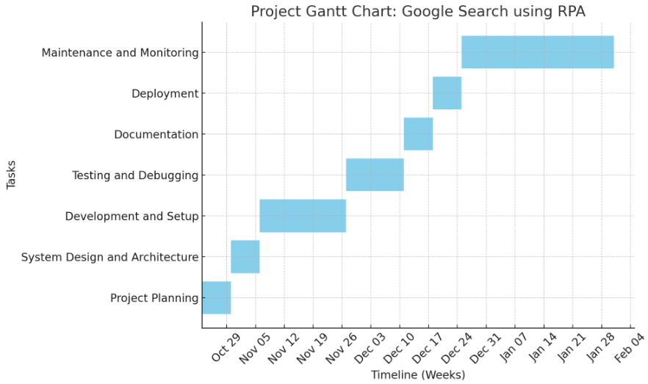
Timeline of Project

Slide 13
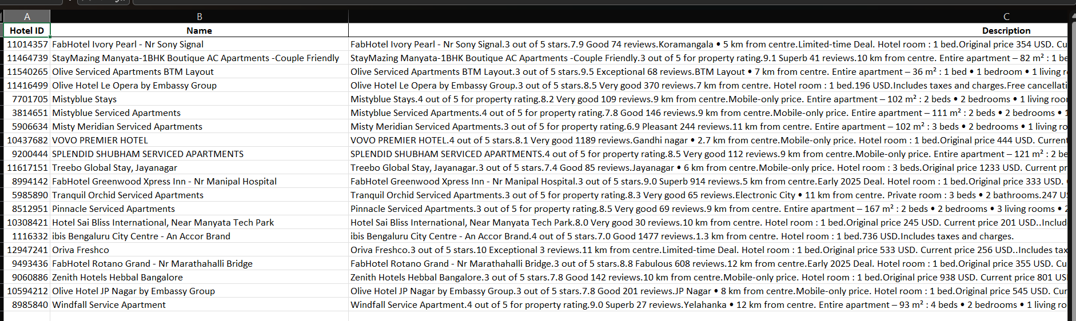
Expected Outcomes

Slide 14
Conclusion
The project aimed at automating the retrieval and processing of hotel data from the Booking.com API using Robotic Process Automation (RPA). The successful implementation of this project has yielded valuable insights into the hotel offerings in Hyderabad, providing a comprehensive list of 21 hotels along with their respective details such as Hotel ID, Name, Description, Ranking Position, and Rating. This information can be very useful for travelers, hoteliers, and travel agencies in making informed decisions and understanding the competitive landscape of the hotel market in Hyderabad.
One of the key findings from the project is the identification of top-ranked hotels. "Blossoms Room The Plaza- Free Lunch Or Dinner" emerged as the highest-ranked hotel with a ranking position of 1 and an impressive rating of 9.5. This hotel owns the number one ranking but also has the attractive feature of offering free lunch or dinner, which might be a substantial selling point for potential guests. Ranking close to them is "FabHotel Prime Srishti Inn - HITECH CITY". Rating 9 and ranking in the position 2. The rating indicates that most guests are fully satisfied with what the hotels offer to them as regards quality service and amenities during their stay, which sets it as first-class accommodation services.

Slide 15
References
[1] S. Aguirre and A. Rodriguez, "Automation in the travel industry: How RPA is transforming business operations," Journal of Business Process Management, vol. 23, no. 3, pp. 345–356, 2017.
[2] L. P. Willcocks, M. C. Lacity, and A. Craig, "The IT function and Robotic Process Automation," The Outsourcing Unit Working Research Paper Series, vol. 15, no. 5, pp. 1–25, 2015.
[3] M. Singh and P. Jain, "Web scraping and API integration: Simplifying data gathering," International Journal of Data Science, vol. 6, no. 2, pp. 45–53, 2018.
[4] K. Sharma, R. Singh, and P. Jain, "Automating data processing using Python-based tools," International Journal of Computer Applications, vol. 178, no. 32, pp. 12–18, 2019.
[5] D. Zeng, Z. Lu, and B. Guo, "Real-time data extraction in the hospitality industry using APIs," Tourism Management Perspectives, vol. 38, p. 100821, 2021.
[6] J. Brock and A. Markou, "Robotic Process Automation: A disruptive technology," Journal of Business Research, vol. 125, pp. 476–487, 2021.
[7] A. Gupta and P. R. Saini, "Application of APIs in automating data extraction processes," International Journal of Computer Applications, vol. 182, no. 22, pp. 20–25, 2020.
[8] R. K. Jain, "The role of Python in modern automation systems," IEEE International Conference on Automation Science and Engineering, pp. 112–118, 2018.

Slide 16
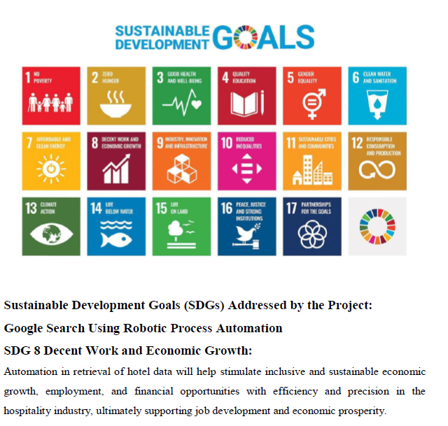
Project work mapping with SDG

Slide 17
Thank You

